Slide 1
Machine Learning Predicts Aperiodic Laboratory Earthquakes
Olha Tanyuk, Daniel Davieau

Slide 2
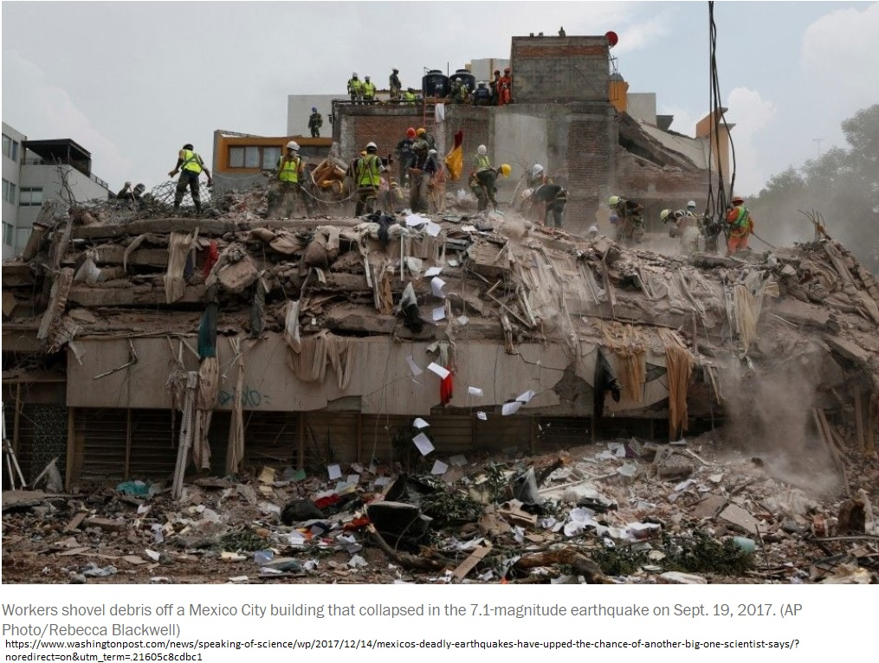
Regular Earthquakes

Slide 3
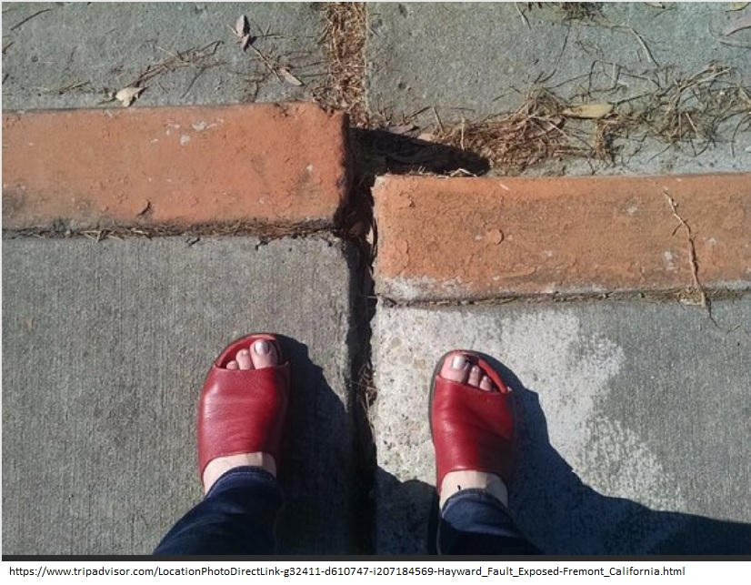
Slow Slip Earthquakes

Slide 4
Los Alamos
In August 2017 Los Alamos National Laboratory (LANL) conducted an experiment [1] that illuminates the mechanics of slow-slip phenomena.

Slide 5
Hacking the Slide Format
Hacking the slide format is allowed
However,
The total number of slides
must be 21
The slides must transition automatically every 15 seconds
The aspect must be the standard format (not 16:9)
The footer information must be present and in the same position as this template

Slide 21
Last Slide
Fade to black after 15 seconds

